Slide 1


Measurement of the top-anti-top differential production cross section in the all-hadronic ﬁnal state using the 2016 proton-proton collision data at sqrt(s) = 13 TeV
National Technical University of Athens
Conference on Recent Developments in High Energy Physics and Cosmology
K. Kousouris, G. Tsipolitis, G. Bakas (NTUA), G.Paspalaki (NCSR Demokritos),
A. Castro, F. Celli (INFN Bologna), P. Kumar Mal (NISER)

Slide 2
Contents
Top Quark
CMS Experiment
Boosted Jets
Analysis
Overview

Slide 3
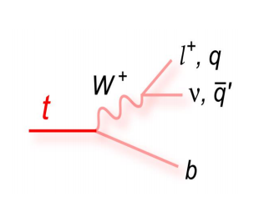
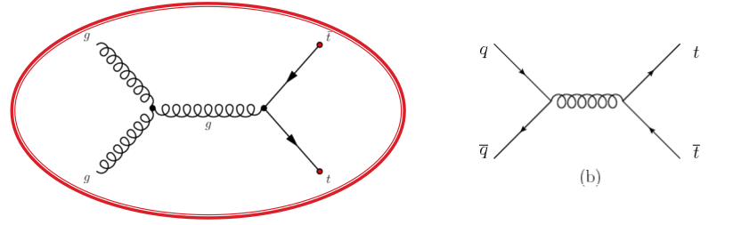
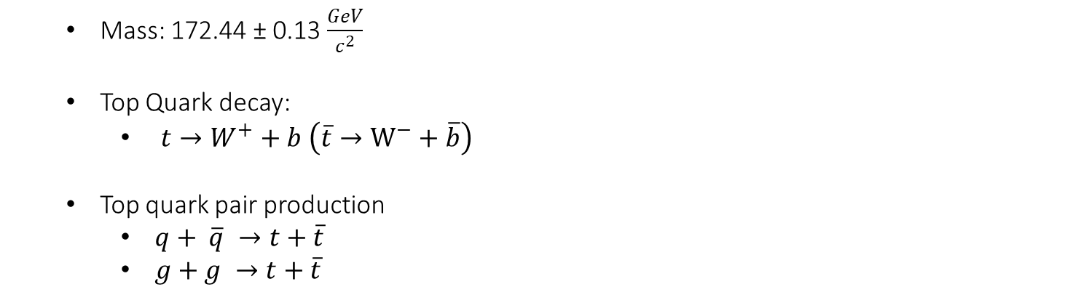
Top Quark
Mass: 172.44 ± 0.13 $\frac{GeV}{c^{2}}$
Top Quark decay:
$t→W^{+}+b \left(\overline{t}→W^{−}+\overline{b}\right)$
Top quark pair production
$q+ \overline{q} →t+\overline{t}$
$g+g →t+\overline{t}$
Gluon Fusion is dominant at LHC

Slide 4
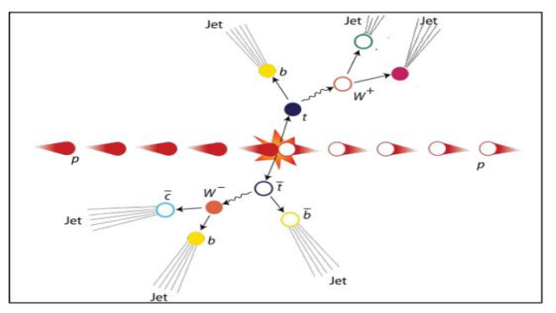
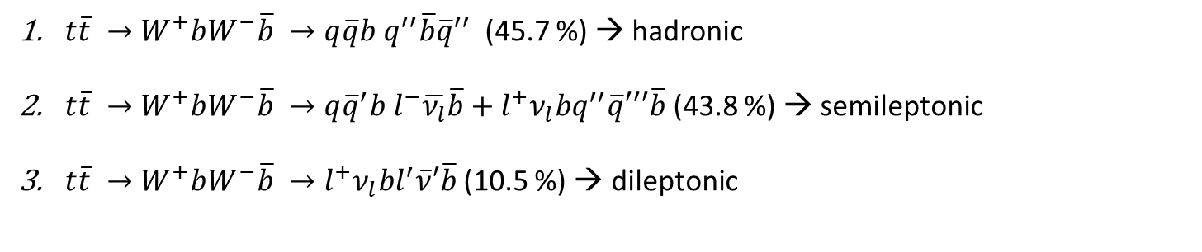
Top AntiTop system decay
$t\overline{t} →W^{+}bW^{−}\overline{b} →q\overline{q}b q^{′′}\overline{b}{\overline{q}}^{′′}$ (45.7 %) → hadronic
$t\overline{t} →W^{+}bW^{−}\overline{b} →q{\overline{q}}^{′}b l^{−}\overline{ν_{l}}\overline{b}+l^{+}ν_{l}bq^{′′}\overline{q}′′′\overline{b}$ (43.8 %) → semileptonic
$t\overline{t} →W^{+}bW^{−}\overline{b} →l^{+}ν_{l}bl^{′}\overline{ν}′\overline{b}$(10.5 %) → dileptonic

Slide 5
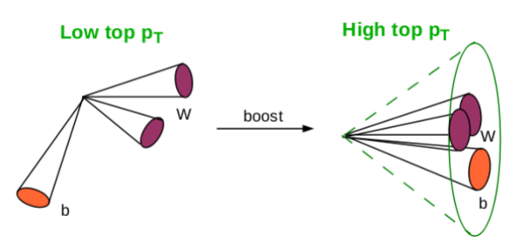
Boosted Jets
Boosted Jets are jets with high p_{T} ( > 400 GeV)
Aim is the reconstruction of two big jets that contain the decay products of the top-antitop quark pair decay
Why Boosted jets?
Single “fat” jet: No combinatorial background
At high top p_{T} the hadronic decay is easier to reconstruct than the leptonic
At high top p_{T} where the theory is less precise → boosted jets
In order to identify boosted jets
Use of sophisticated reconstruction techniques to identify the substructure within the jet
SoftDrop technique to eliminate soft contributions

Slide 6
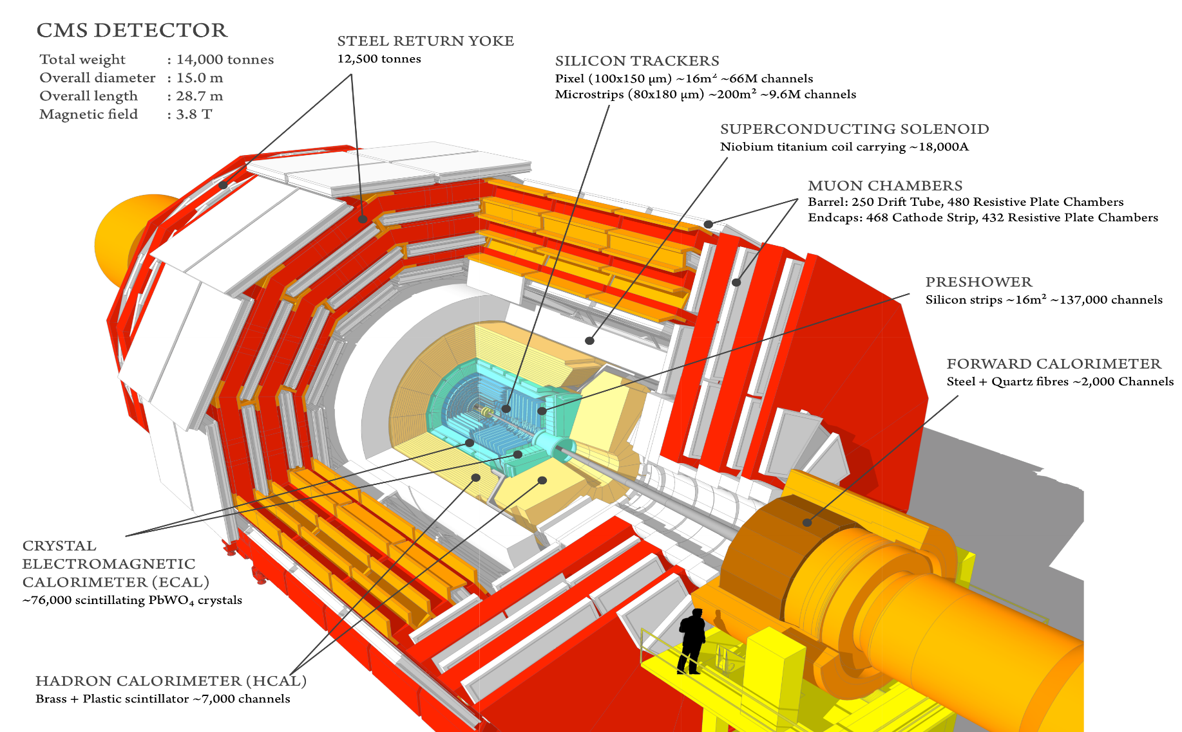
Compact Muon Solenoid Experiment
CMS is a general purpose detector and its goal is to investigate a wide range of physics

Slide 7
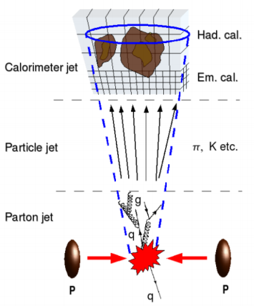
Analysis Overview
2016 dataset
Very well understood (calibrations, scale factors, etc)
Trigger: two AK8 jets at HLT and b tagging
Selection:
two AK8 jets with p_{T} > 400 GeV
tag a ttbar event with MVA that uses the jet substructure variables as inputs
categories based on subjet b-tagging:
0-btag: control region
2-btag: signal region
Background
QCD dominant: taken from data
Single Top, W/Z +jets are negligible
Deliverables
Differential cross sections in fiducial, parton and particle level
Five observables: top p_{T} and top η, ttbar system mass, p_{T} and rapidity

Slide 8
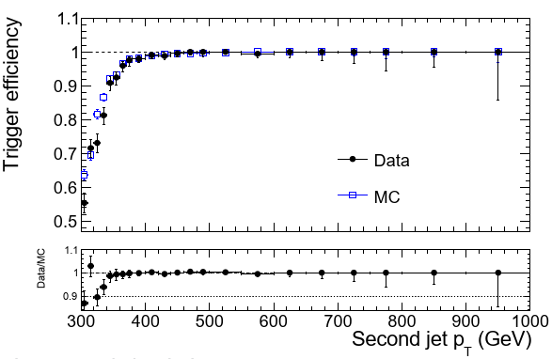
Trigger
Level 1 Trigger:
L1 SingleJet180 OR L1 SingleJet200
Hight Level Trigger:
Signal path: HLT_AK8DiPFJet280_200_TrimMass30_BTagCSV p20
Aims to capture the decay products of boosted top pair
p_{T,1} > 280 GeV and p_{T,2} > 200 GeV
Jet mass > 30 GeV
At least one of the 2 jets should be b-tagged
Efficiency measured wrt orthogonal muon trigger
Control path: HLT_AK8DiPFJet280_200_TrimMass30
Same kinematics, no HLT b-tagging
Analysis Region
Trigger Efficiency vs Subleading jet p_{T} (GeV)

Slide 9
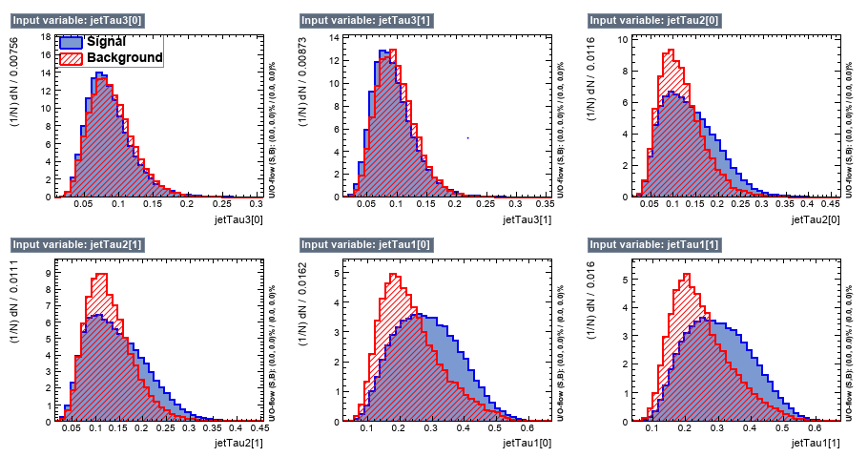
Multivariate Discriminant Analysis(variables)
Discriminating variables used for separation of the $t\overline{t}$ from the QCD events

Slide 10
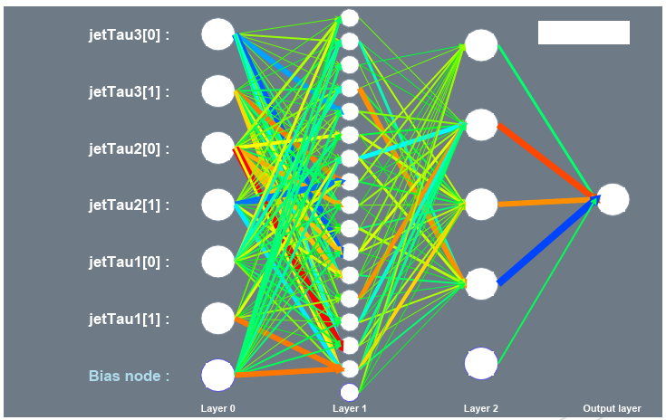
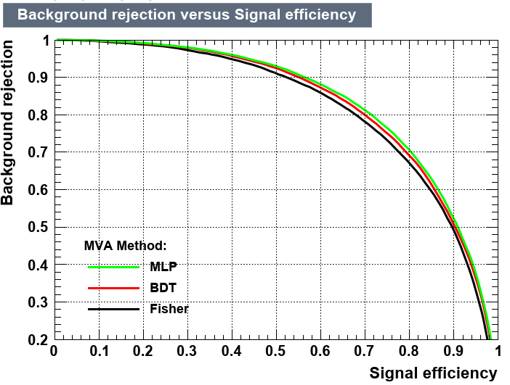
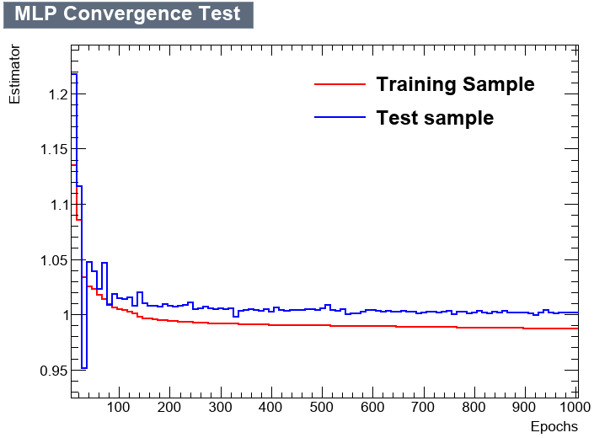
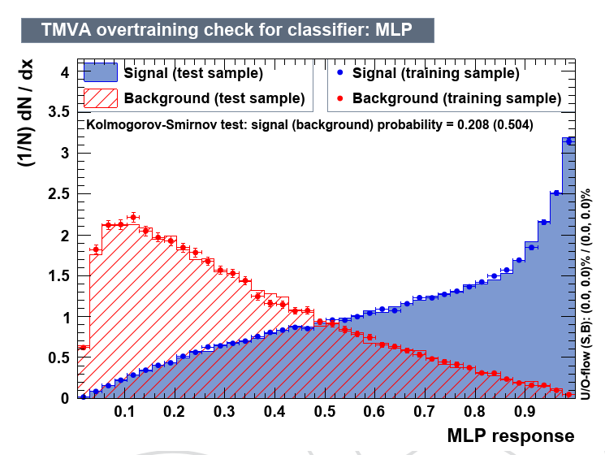
Multivariate Discriminant Analysis (training)

Slide 11
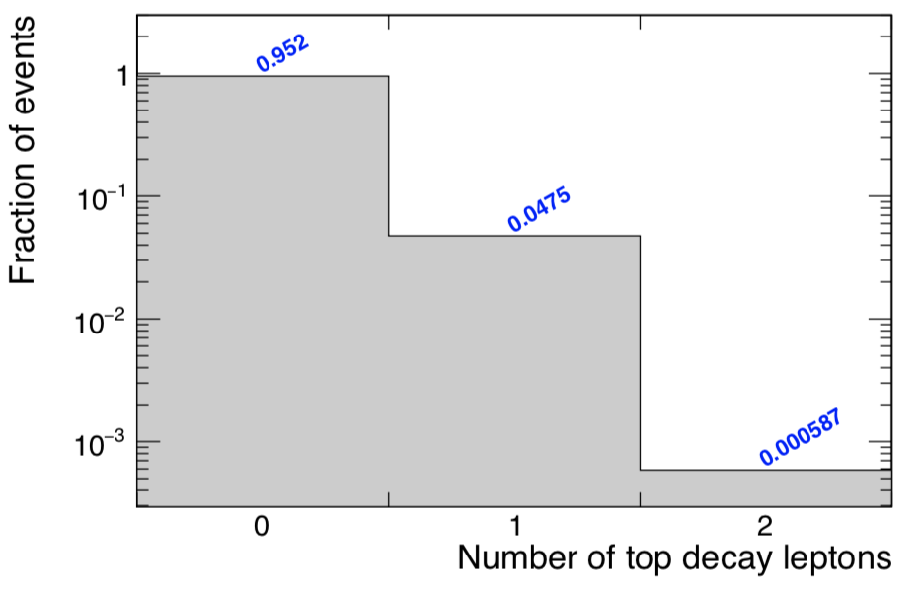
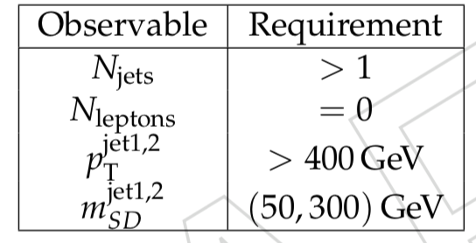
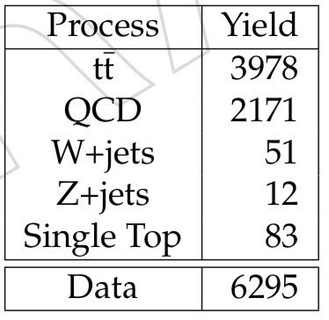
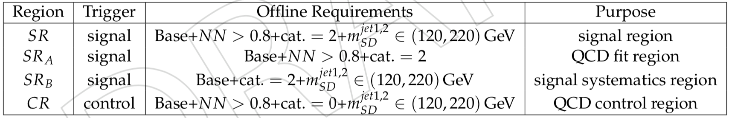
Selection
Baseline Selection
Selected jets: AK8 PF+CHS
From signal selection almost 95% of the decays are hadronic
Table: Selection requirements per analysis region

Slide 12
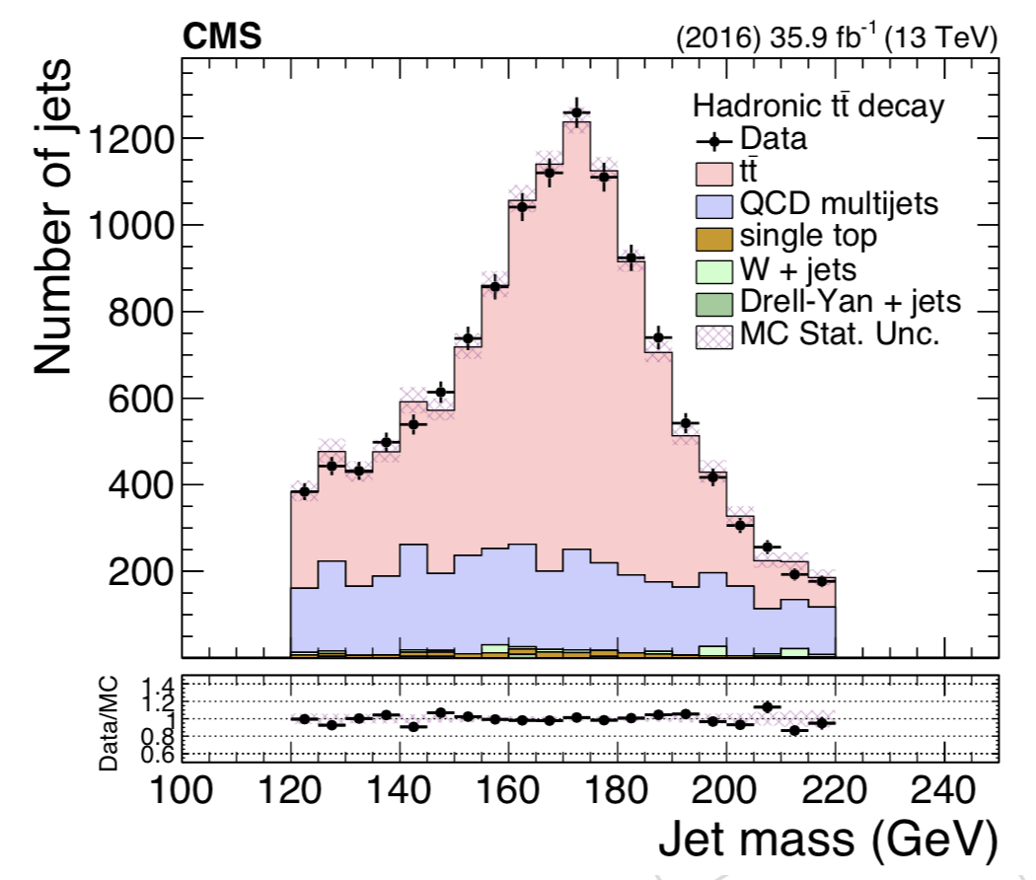
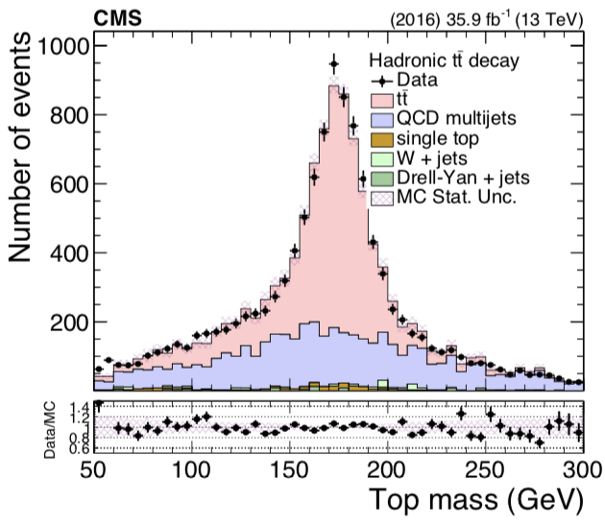
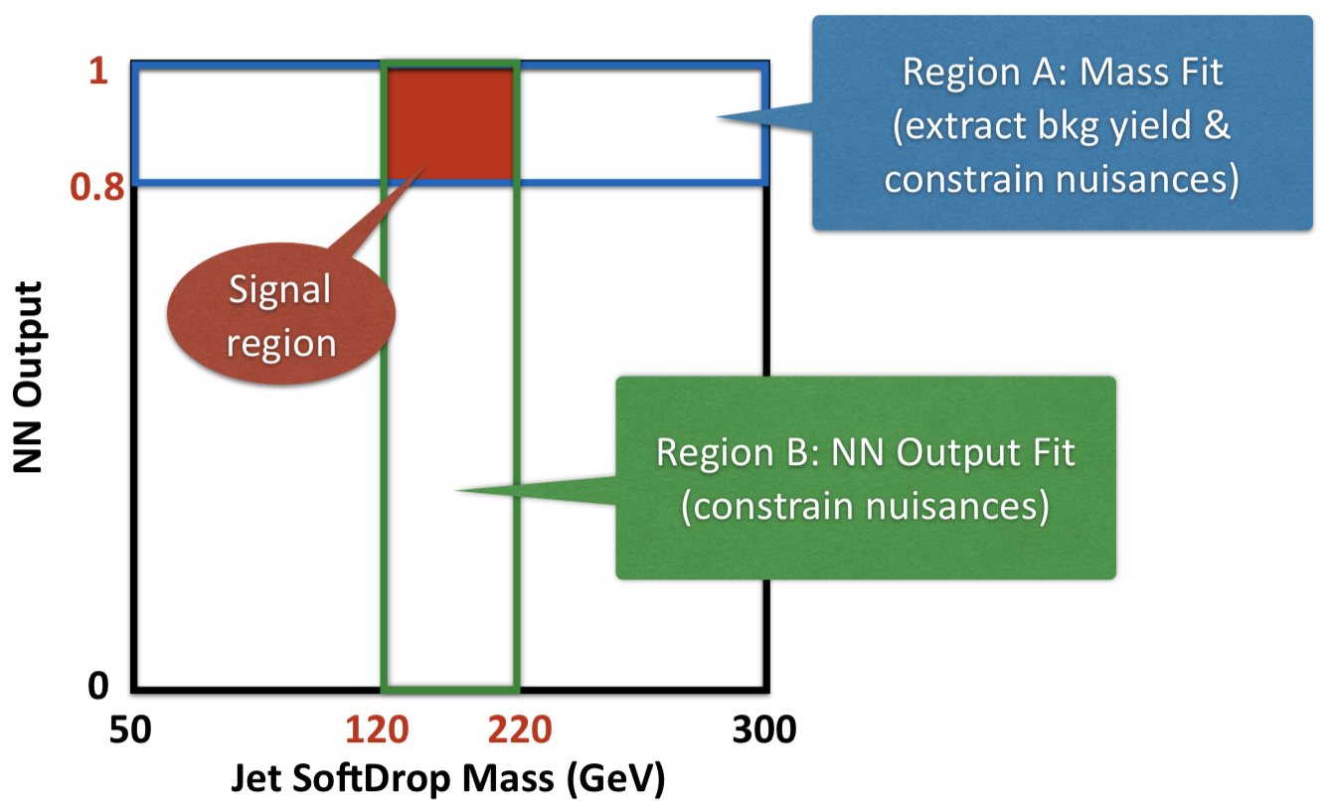
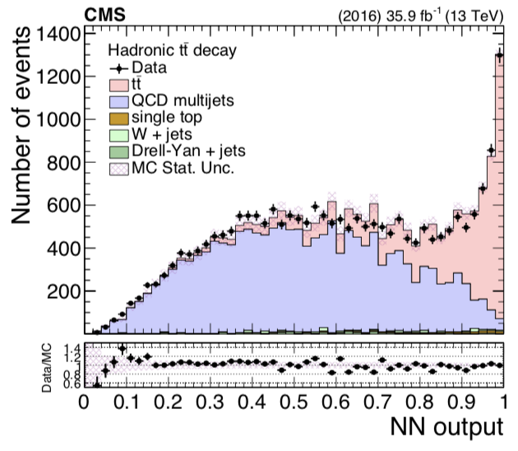
Analysis Regions

Slide 13
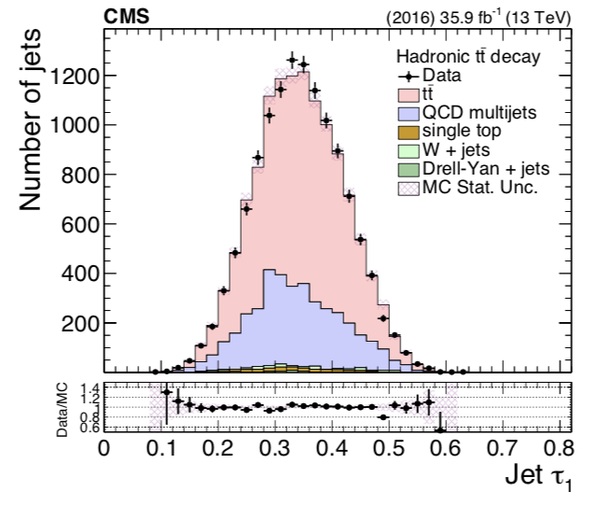
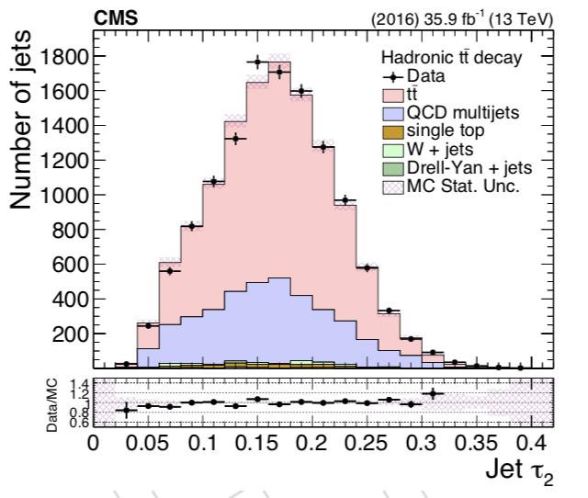
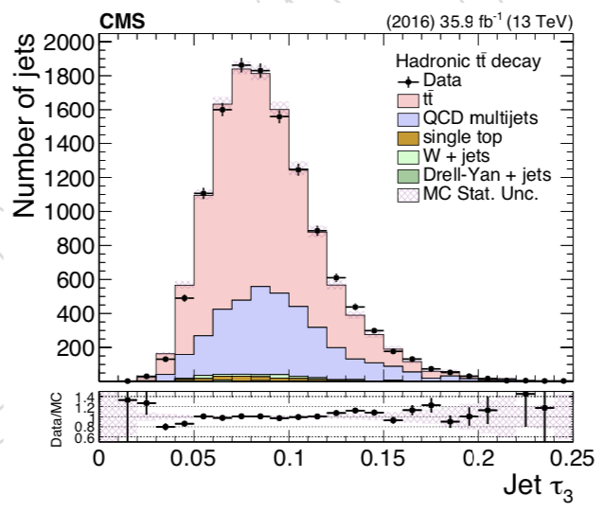
Data vs MC: Substructure Properties

Slide 14
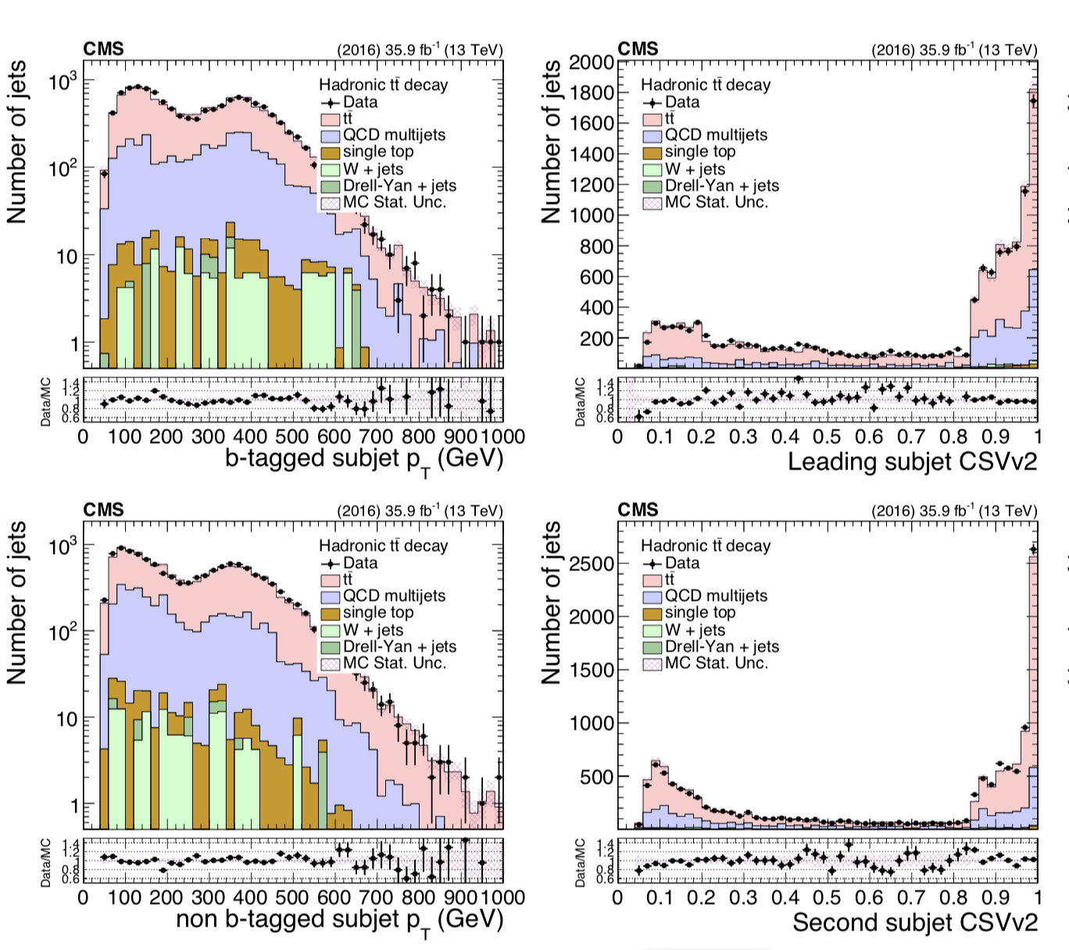
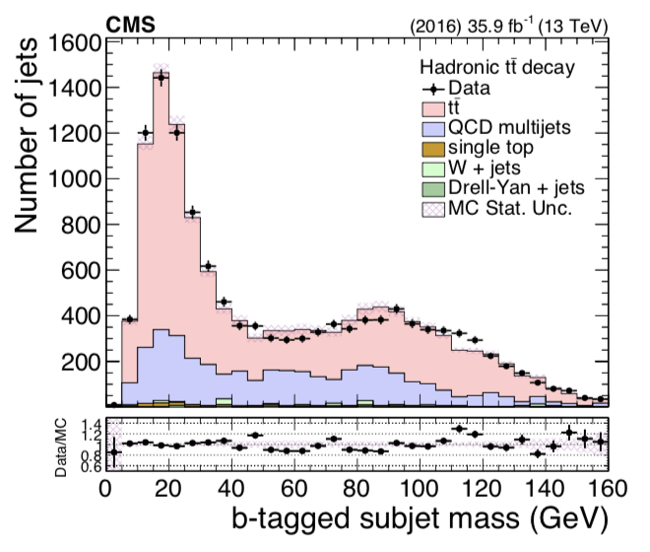
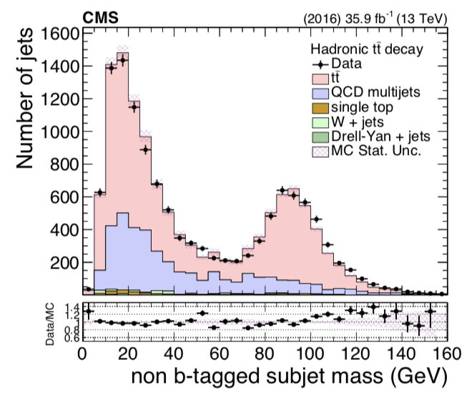
Data vs MC: Subjet Properties

Slide 15
Signal Extraction
Transfer factor from SR_{A} to SR
Bkg Shape Correction
(taken from MC)
Fiducial Yield
$$S_{fid}\left(x_{reco}\right)=D\left(x_{reco}\right) −R_{yield}N_{qcd}C_{bkg}^{shape}Q\left(x_{reco}\right)$$
Data
Bkg Shape
(taken from CR in data)
Bkg Yield
(fit in region SR_{A})

Slide 16
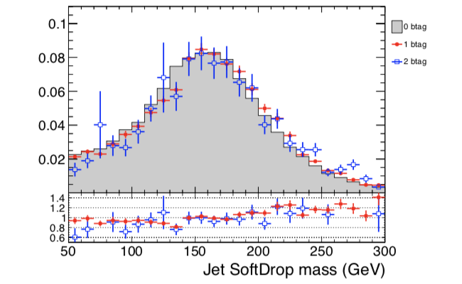
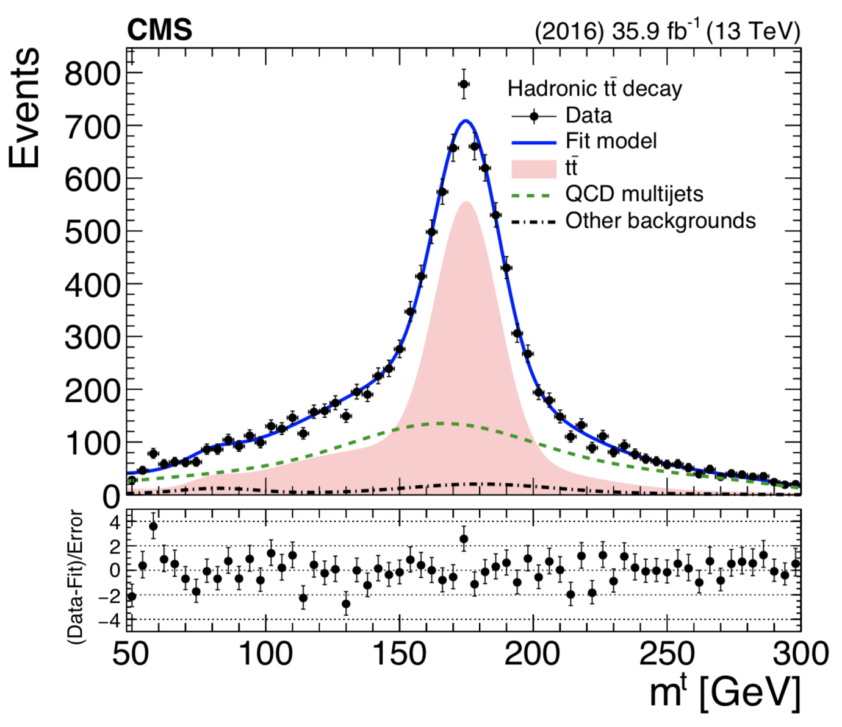
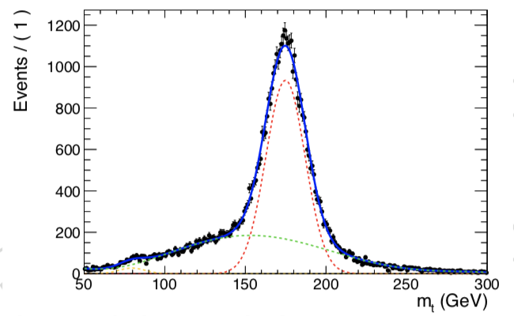
Fit in the SR_{A} Region

Slide 17
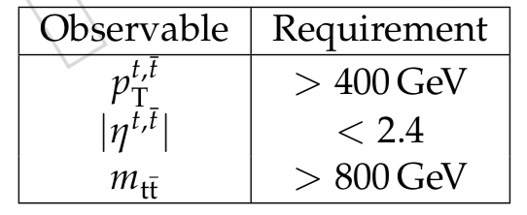
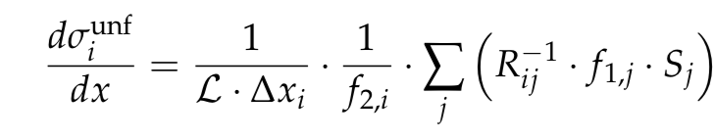
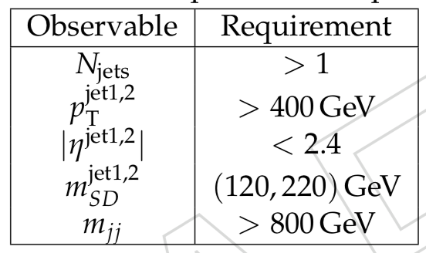
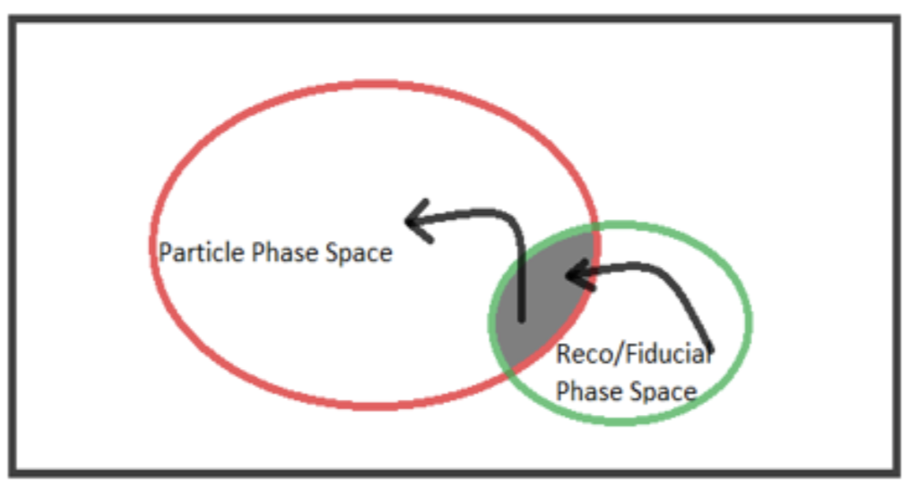
Particle and Parton Levels
Parton Level selection
Reco and parton(particle) over parton(particle)
Reco and parton(particle) over parton (particle)
Migration matrix
Particle Level selection
Unfolding is done using simple response matrix inversion without regularisation

Slide 18
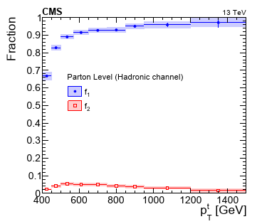
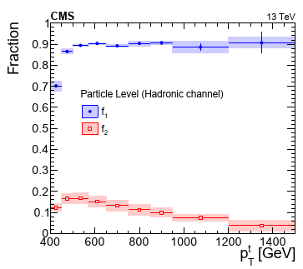
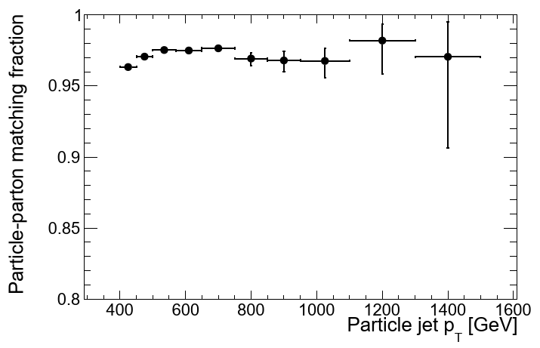
Extrapolation factors for particle & parton levels
f₁: fraction of reco events in the reco+parton/particle phase space
f₂: fraction of reco events in the reco+parton/particle phase space
Particle to parton matching efficiency

Slide 19
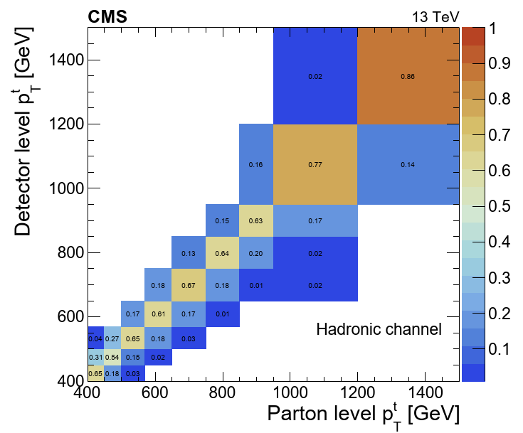
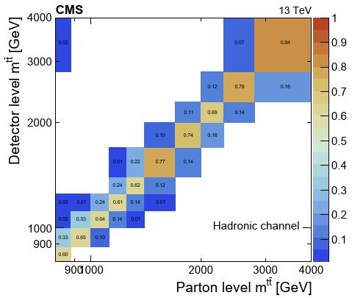
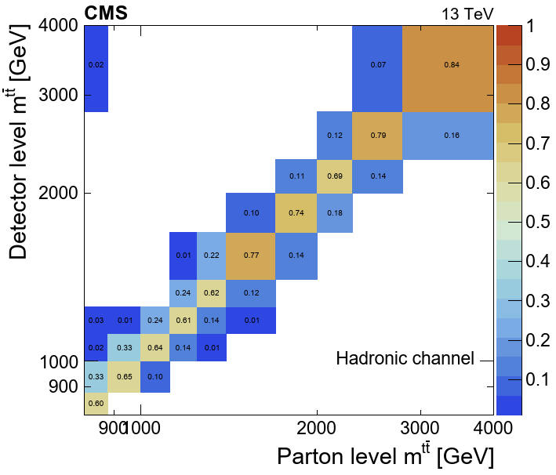
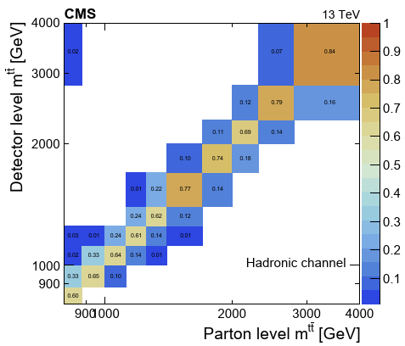
Migration Matrices

Slide 20
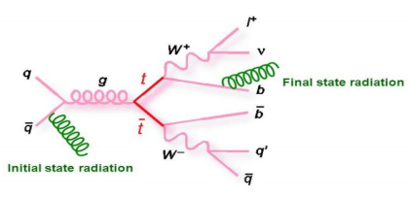
Uncertainties
Experimental:
QCD background prediction
Statistics
Jet Energy Scale
Jet Energy Resolution
B tagging efficiency
Theoretical:
Affect the extrapolation factors (f₁ , f₂) and the migration matrices for the unfolding procedure
ISR (Initial State Radiation)
FSR (Final State Radiation)
CMS tuned set of MC parameters for Pythia 8

Slide 21
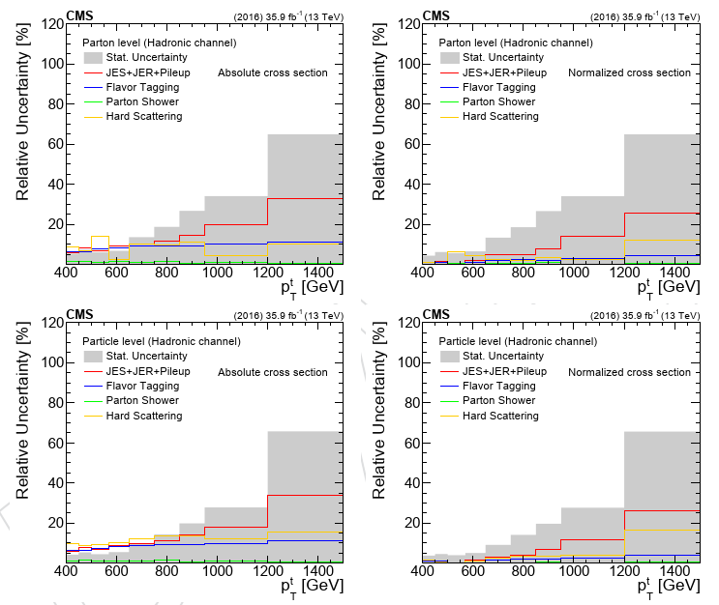
Uncertainties
Uncertainties for the parton and particle level measurements
(normalized)
Uncertainties for the parton and particle level measurements
(absolute)

Slide 22
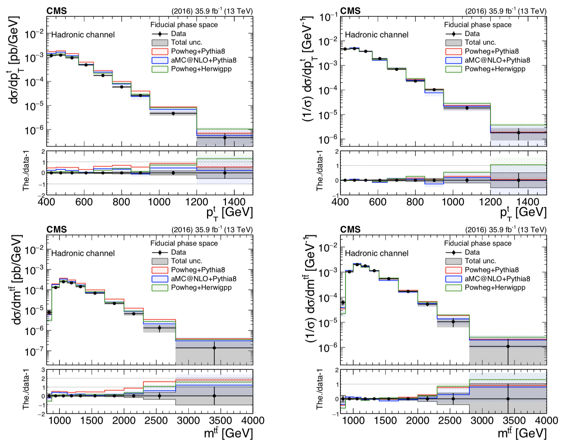
Results for Fiducial Measurement (top p_{T} , m_{tt})

Slide 23
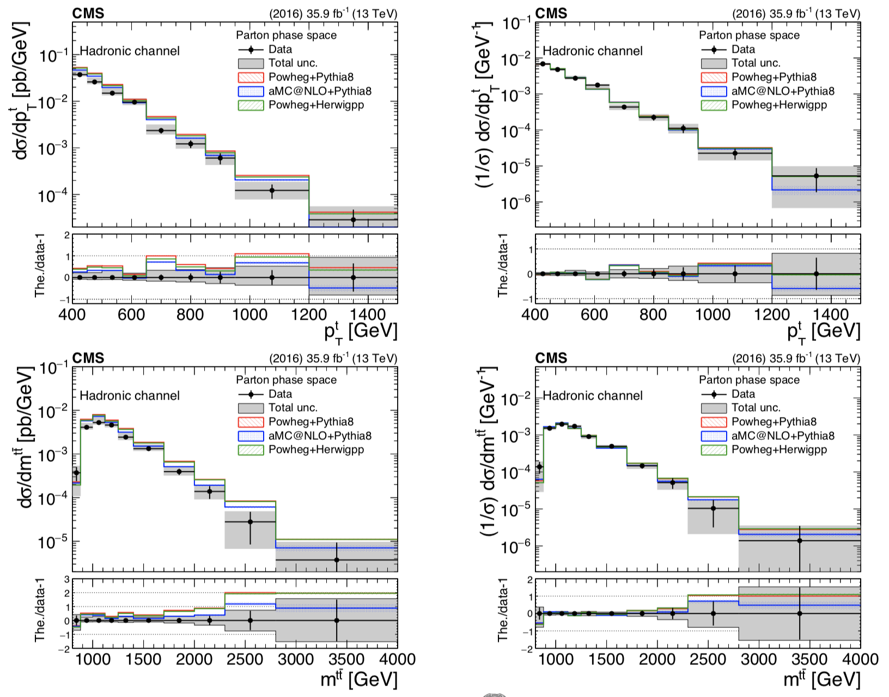
Results for Parton Measurement (top p_{T} , m_{tt})

Slide 24
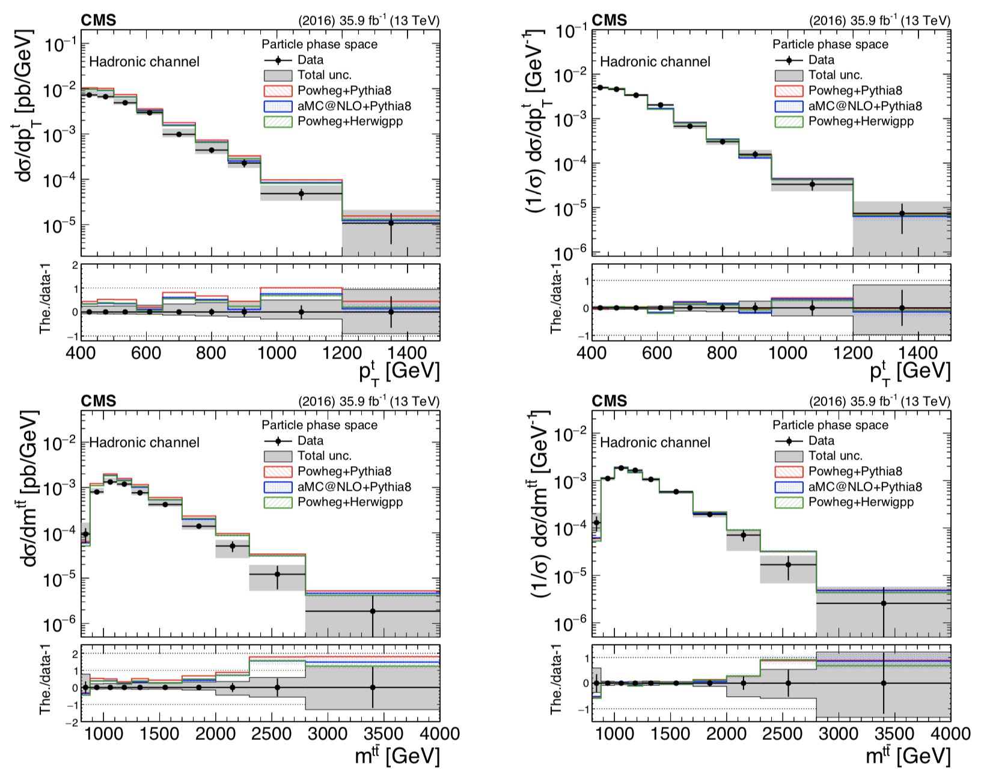
Results for Particle Measurement (top p_{T} , m_{tt})

Slide 25
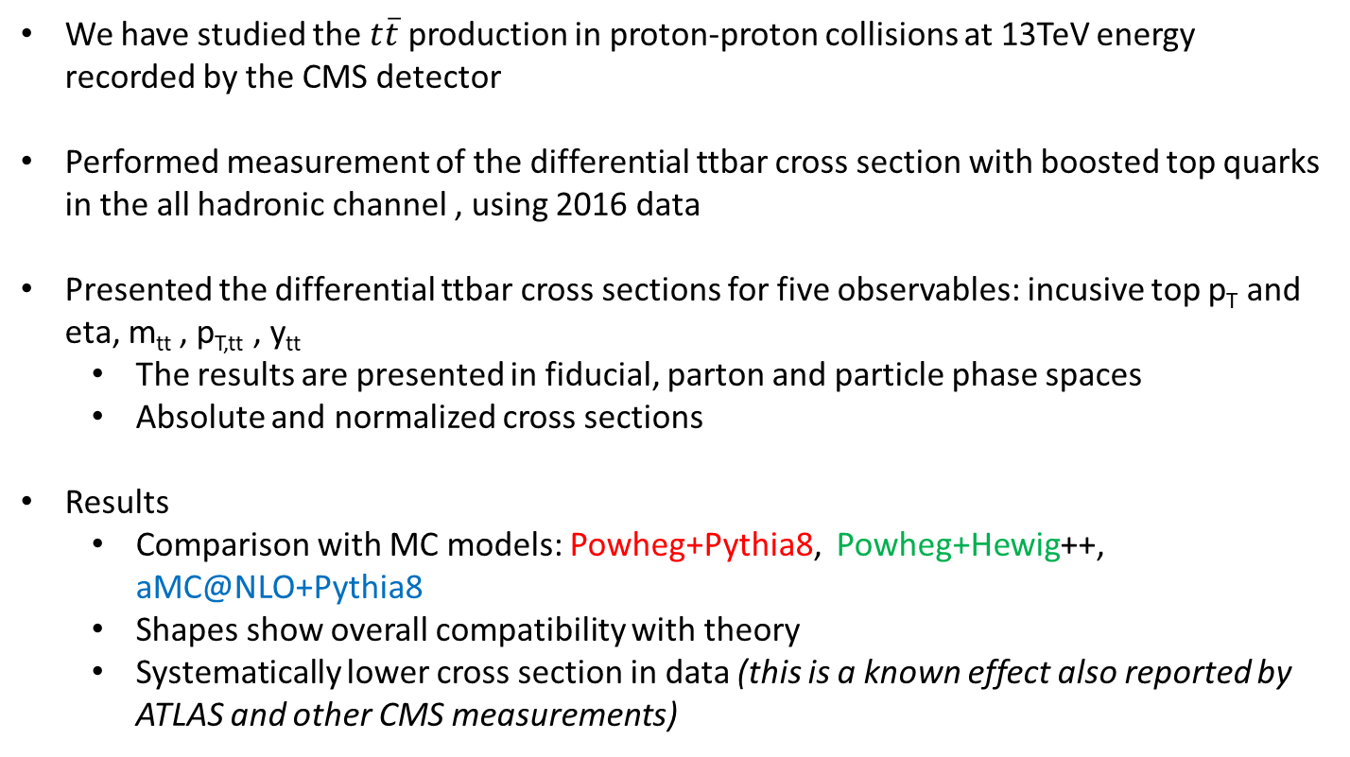
Results for Particle Measurement (top p_{T} , m_{tt})
We have studied the $t\overline{t}$ production in proton-proton collisions at 13TeV energy recorded by the CMS detector
Performed measurement of the differential ttbar cross section with boosted top quarks in the all hadronic channel , using 2016 data
Presented the differential ttbar cross sections for five observables: incusive top p_{T} and eta, m_{tt} , p_{T,tt} , y_{tt}
The results are presented in fiducial, parton and particle phase spaces
Absolute and normalized cross sections
Results
Comparison with MC models: Powheg+Pythia8, Powheg+Hewig++, aMC@NLO+Pythia8
Shapes show overall compatibility with theory
Systematically lower cross section in data (this is a known effect also reported by ATLAS and other CMS measurements)

Slide 26
Thank you for your attention!

Slide 27
BACKUP SLIDES

Slide 28
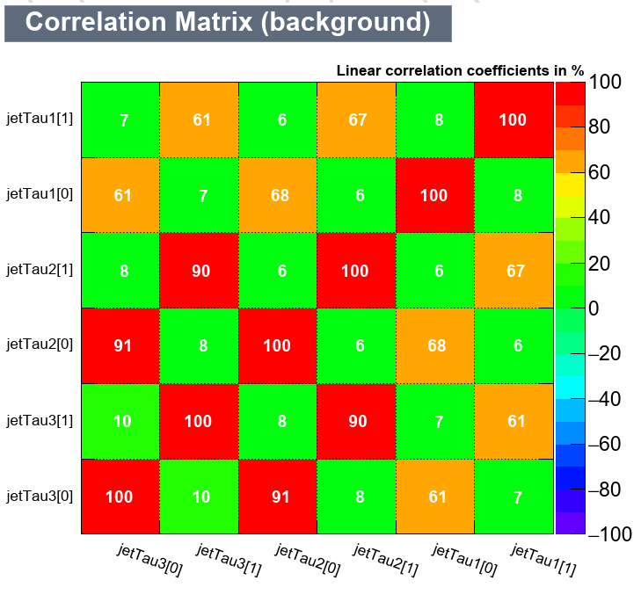
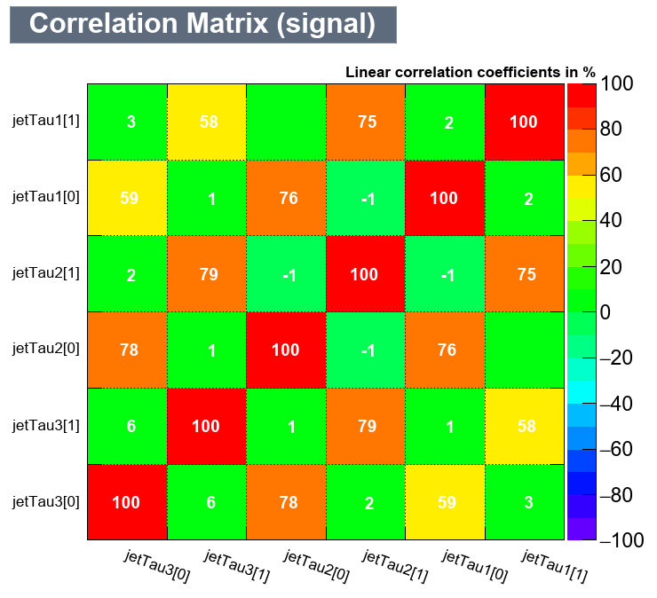
MVA training: Correlation Matrices

Slide 29


Data vs MC: Top jet Kinematics

Slide 30



Data vs MC: ttbar Kinematics

Slide 31






Migration Matrices

Slide 32






Fiducial Results for η^{t} , p_{T,tt}, y_{tt}

Slide 33






Parton Results for η^{t} , p_{T,tt}, y_{tt}

Slide 34






Particle Results for η^{t} , p_{T,tt}, y_{tt}

